Slide 1
Simulating the Fuselage Steps

Slide 2
A video explaining simulation basics (40 mins)

Slide 3
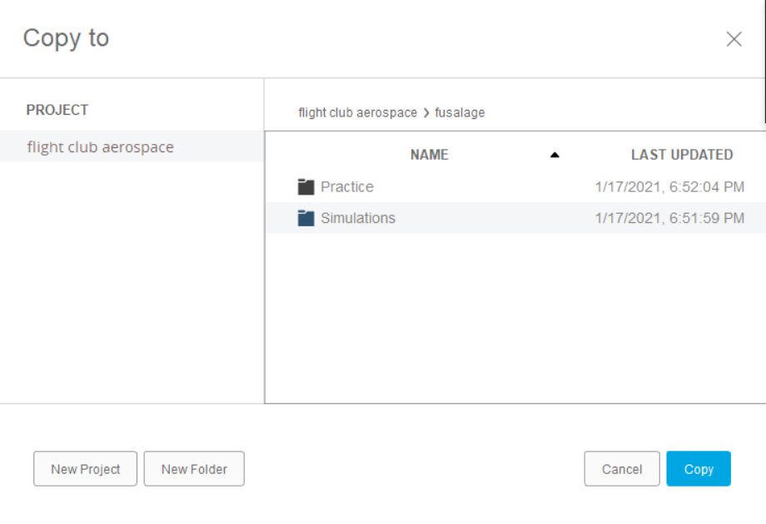
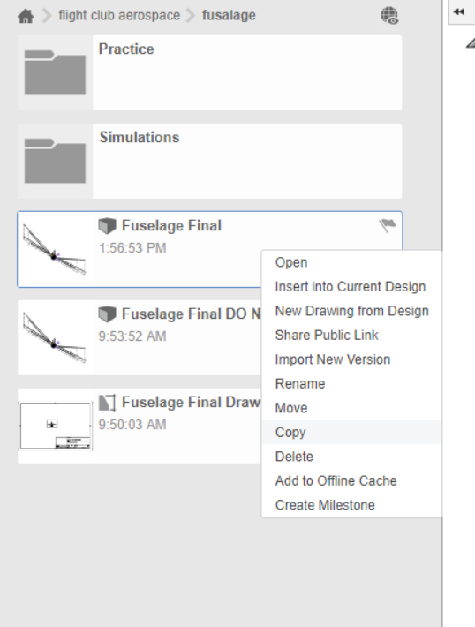
Make a copy
Right click the “Fuselage Final” and click make a copy
You’ll get this - double hit “simulations” then bottom right “copy”

Slide 4
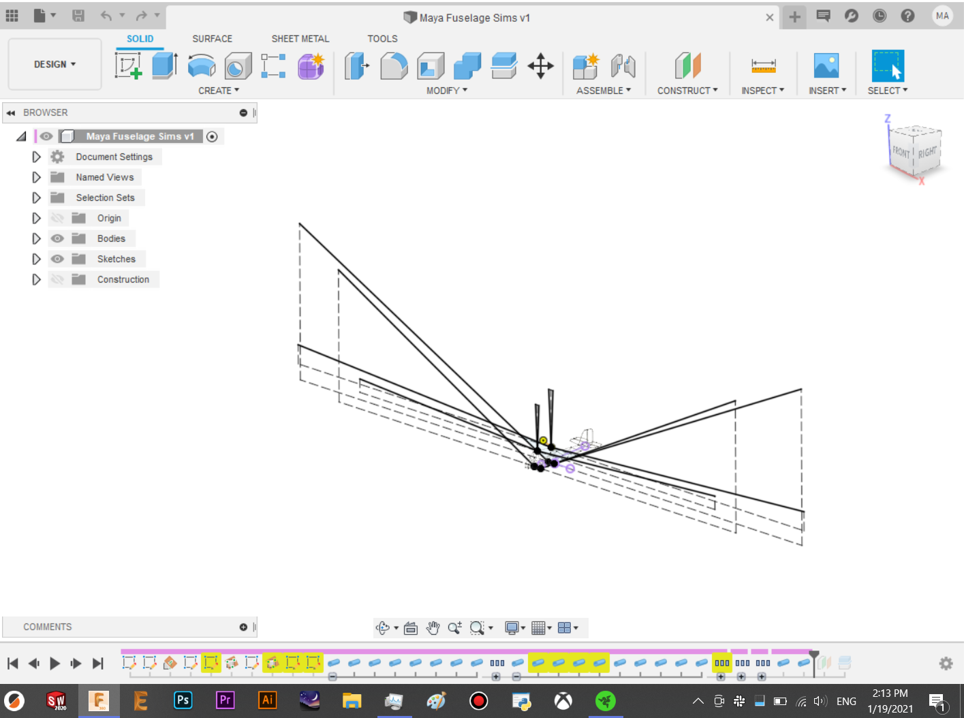
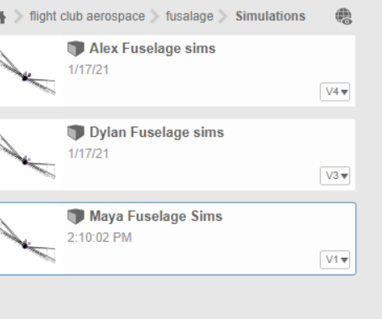
copy
→
Rename it to ur name under the fuselage> simulations folder

Slide 5
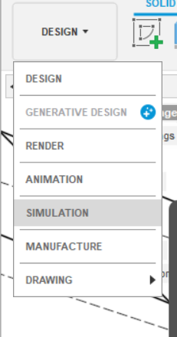
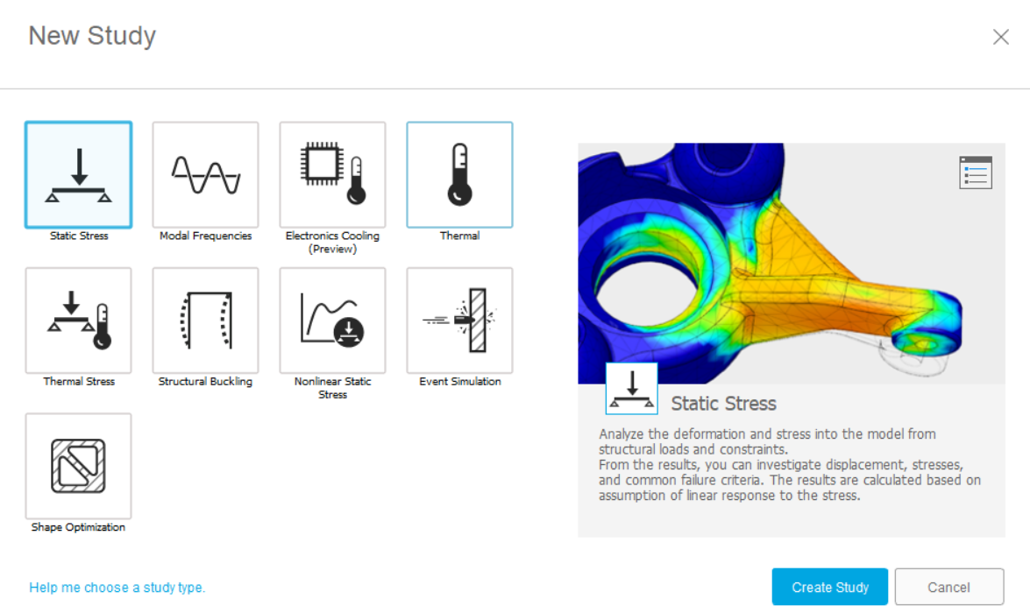
Creating a study
→ static stress study
Top left → simulation

Slide 6
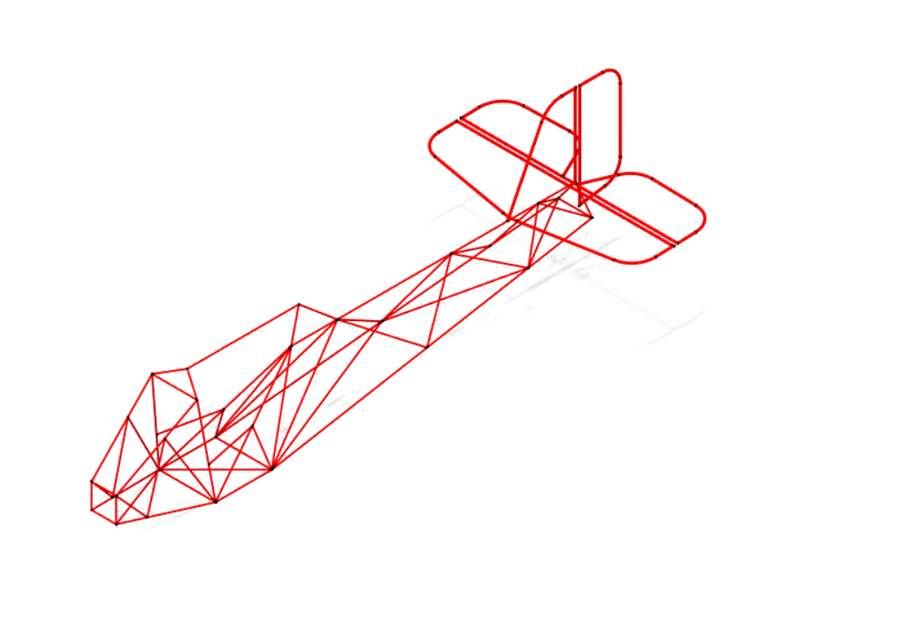
Constraints
Hit that button. At first your fuselage should look like this:
That means your entire thing is unconstrained and you can’t run the sim yet

Slide 7
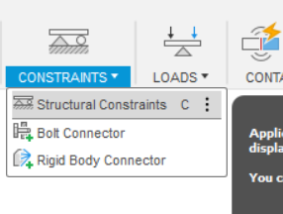
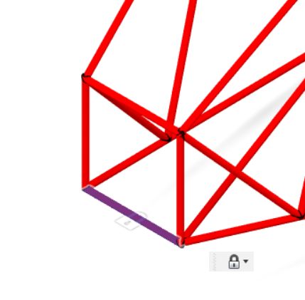
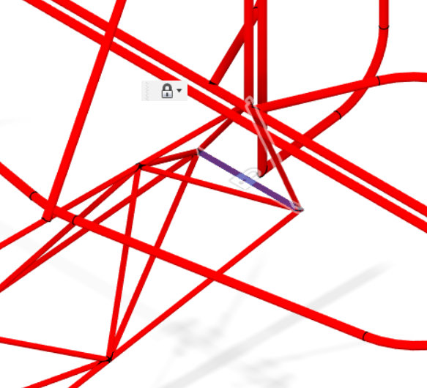
Constraints 2
Ok now click these two beams
All the way in the front.
Bottom end of fuselage
Aye now you’re gonna start making this bad boy green
Structural constraints
Psa: i have zero idea what would actually make the most logical sense for the constraints LOL

Slide 8
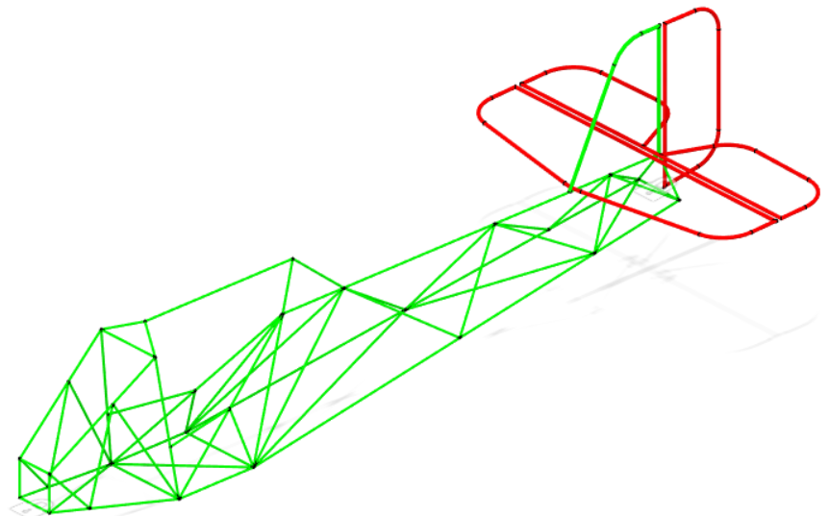
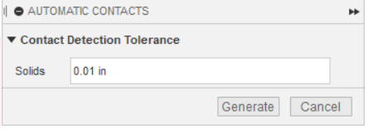
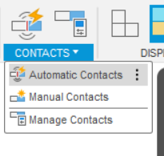
Contacts:
Yay you’re getting there! You should be here:
click “automatic contacts and set it to like 0.01 in (no idea that’s just what I do)
→
Also lol i just realized i’ve been making text boxes for arrows instead of making shapes

Slide 9
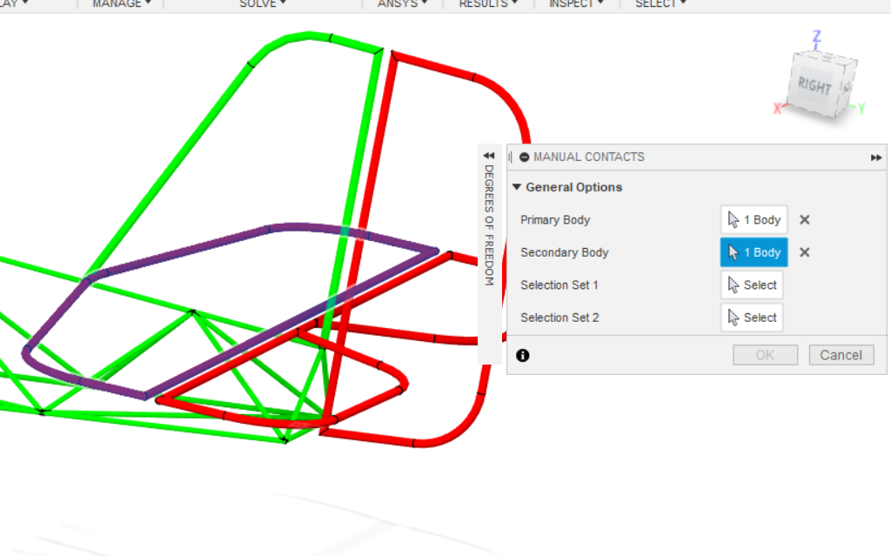
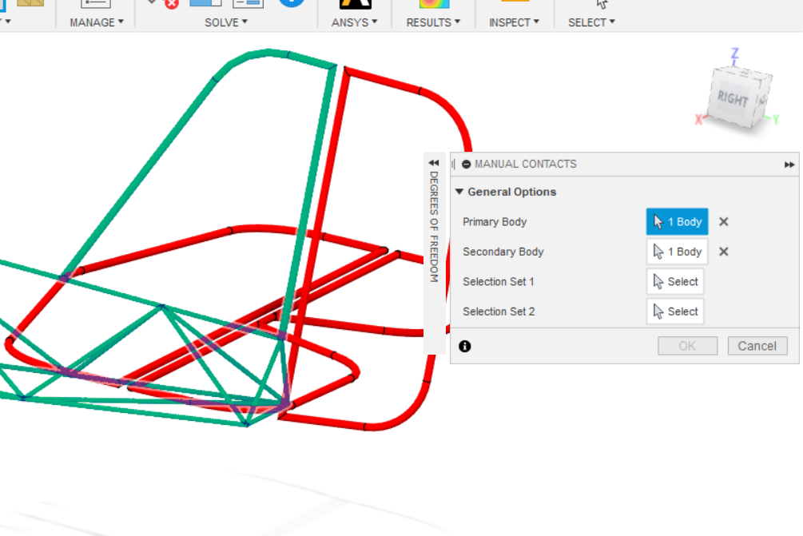
Manual Contacts
Okay sicko mode! Now time to constraint the horizontal stabilizer (HS), elevator, rudder
1
2

Slide 10
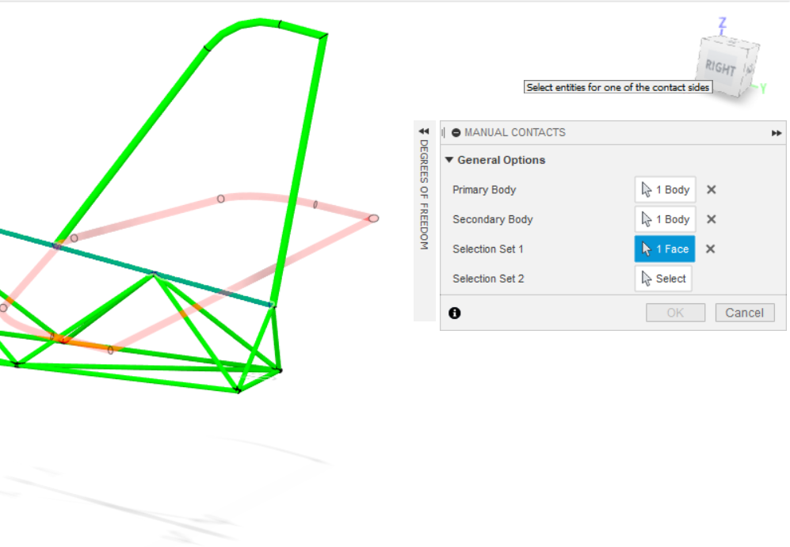
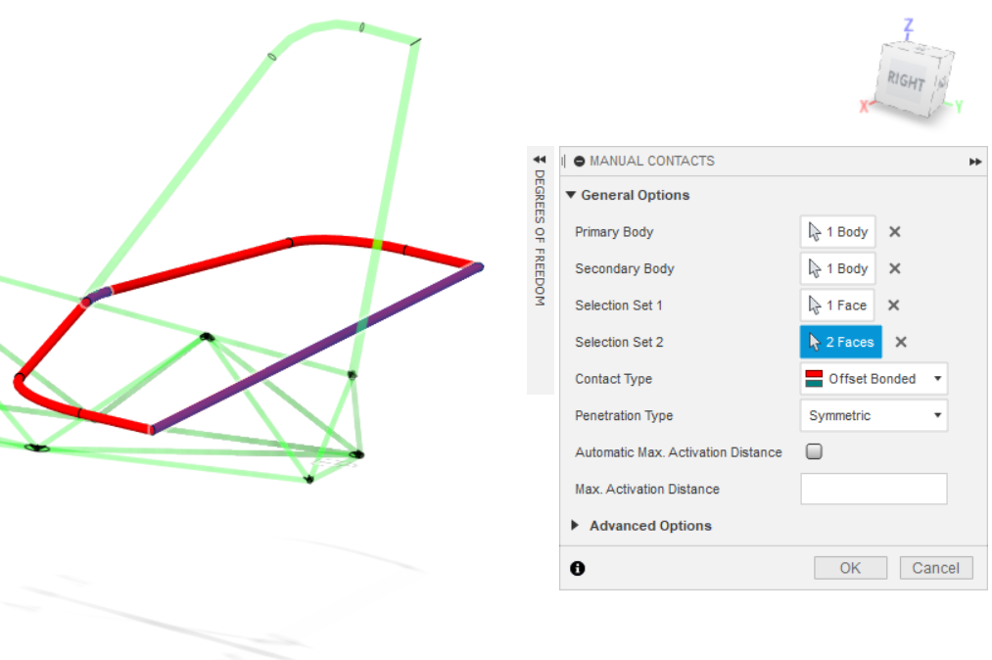
Manual Contacts 2
3
4
Click the faces that would be constrained to each other in real life
Also: offset bonded!

Slide 11
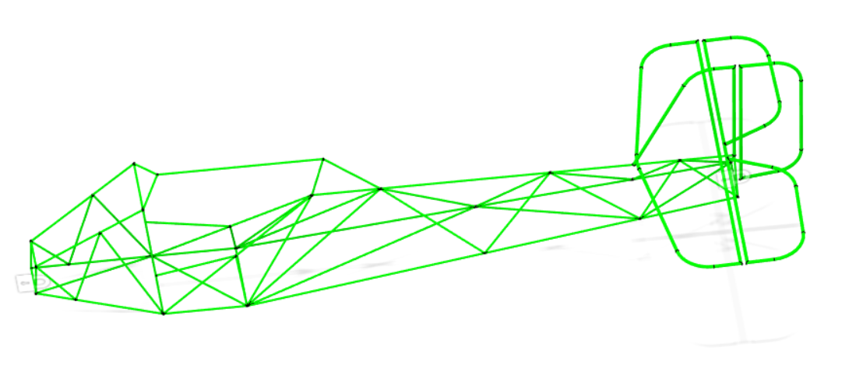
Okay now repete with the rudder and elevator
You should have this:
Yay! If not: oof. Let someone in #design know

Slide 12
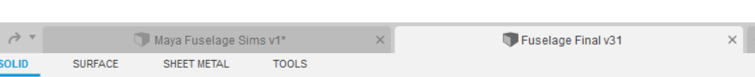
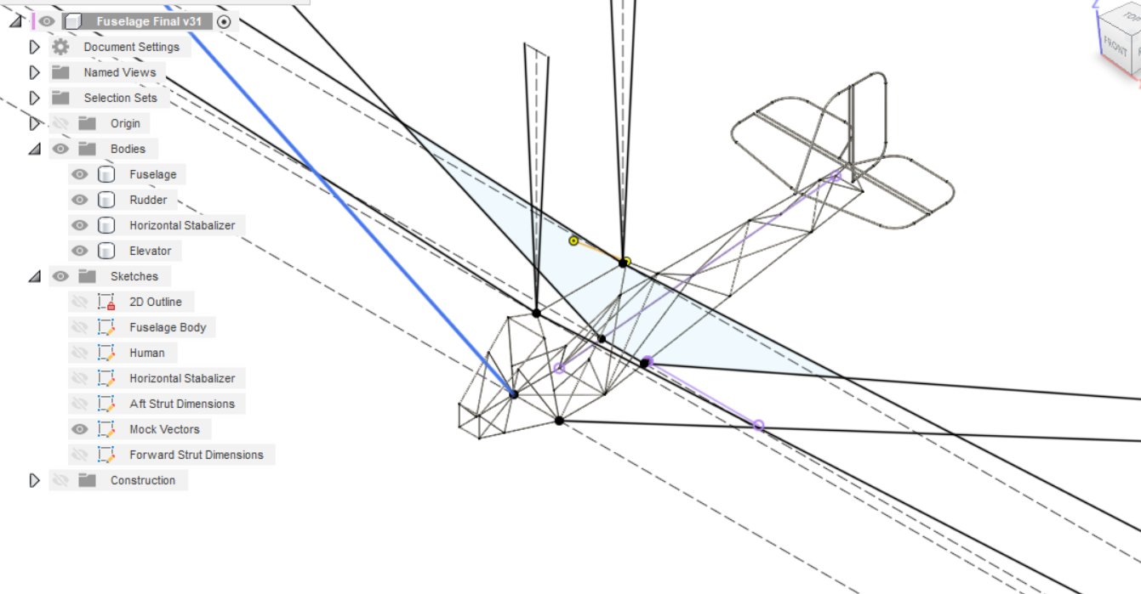
Yay onto forces!
Have both open. You’re gonna get magnitude, placement, and angles from the “Mock Vectors” Sketch
Let’s start out with just two. The forward strut forces.

Slide 13
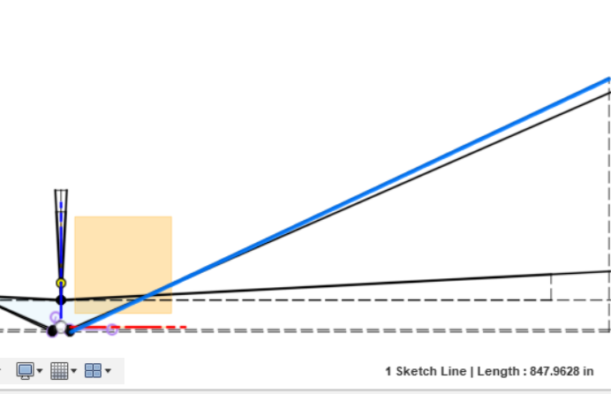
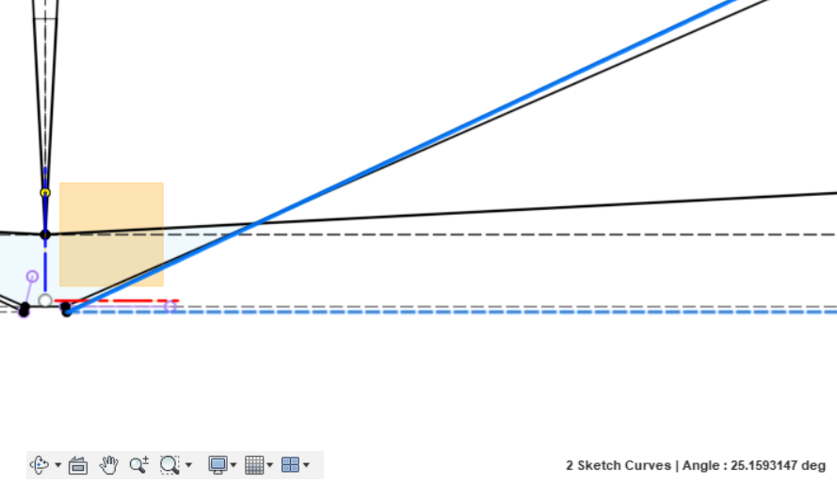
Forces 2
Press shift and get the horizontal line and the force vector you want
Find your angles and magnitude of the force with
Magnitude: just click the line. The length is the magnitude in lb

Slide 14
Okay now that you know the process: you can use this spreadsheet to keep log of all the forces so we don’t have to all do it a million times
Spreadsheet link: https://docs.google.com/spreadsheets/d/1iS6XN_SRHU6PhWOXxYDhPX_BEyqE1HM1dvrLqCGod_8/edit#gid=0

Slide 15
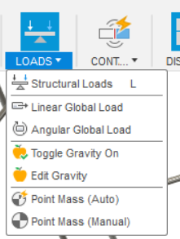
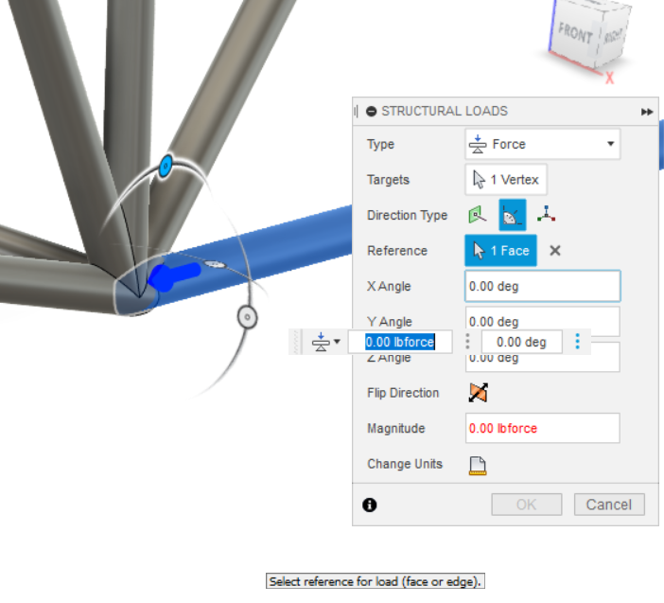
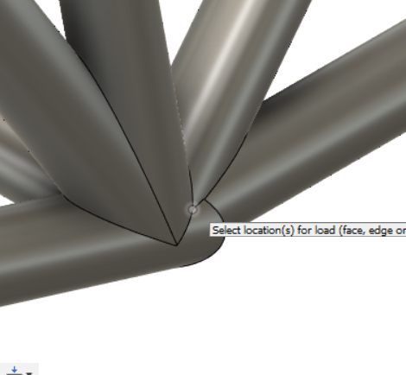
Forces 3
Use the horizontal beam as a reference for the angles
Take the dimensions you had and go back to ur sim tab
We’ll fix the force in a sec

Slide 16
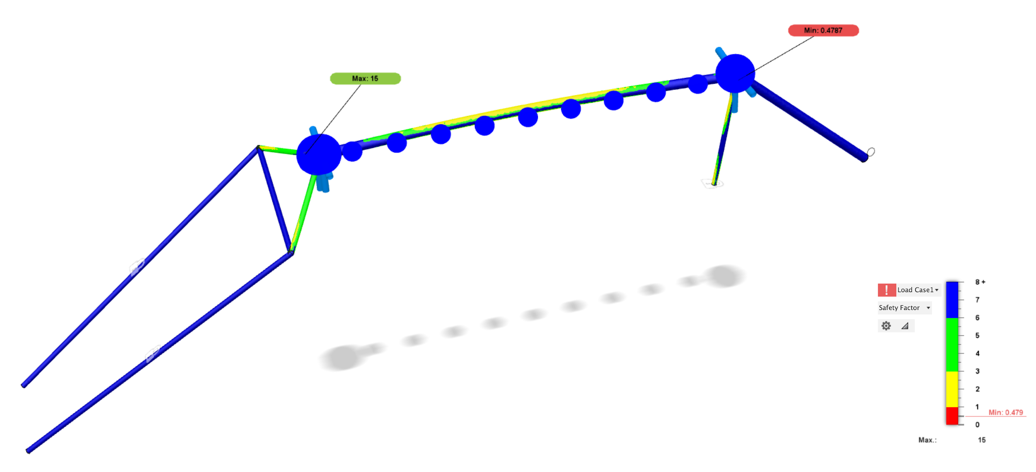
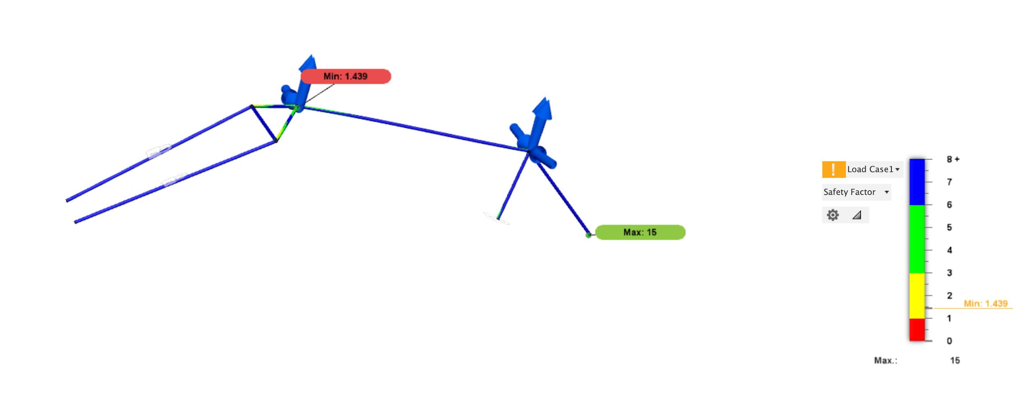
Note: DO NOT USE REMOTE FORCES
You get really janky stuff:
Force
Remote force:
Same magnitude and placement. Remote gave many compression through the longeron which to our knowledge is incorrect

Slide 17
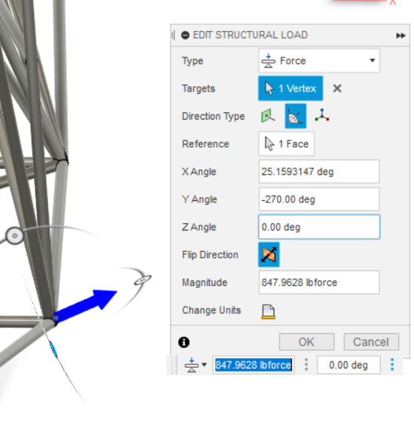
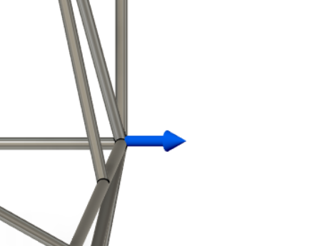
Forces 4
Top View
Note: Flip the Direction for the strut so it is pulling

Slide 18
Sicko mode! Now do the other side! You got this!

Slide 19
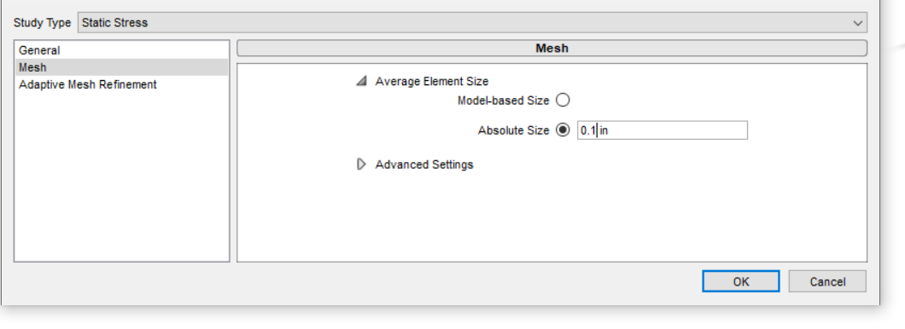
Mesh
Set your mesh size to absolute size then 0.1 in. We have really tight joints, so that’s how small it needs to be.

Slide 20
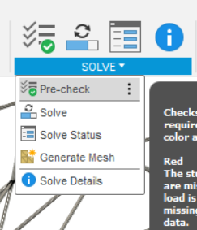
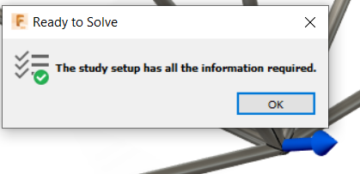
Final Moves
Go to precheck:
If you got this: congrats! You did it good!

Slide 21
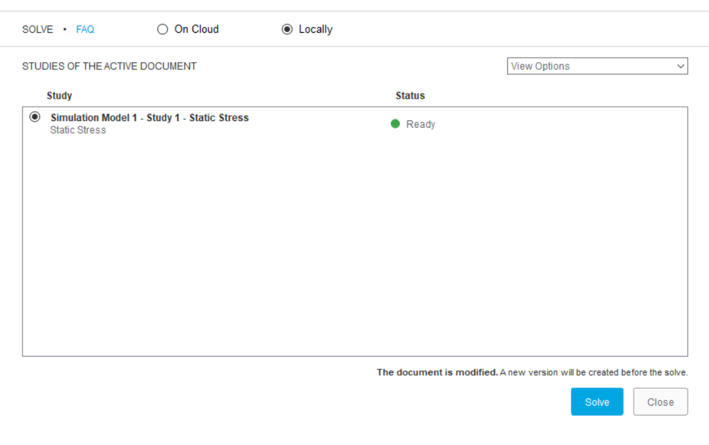
Solve
Only thing here is switch it to “Locally” at the top. You need to pay money to do it on the cloud.
Also close off all other applications while it’s running. It’s gonna need a solid 3 hrs - if it takes longer then shut it off something’s wrong.

Slide 22
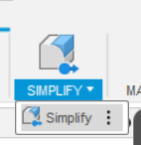
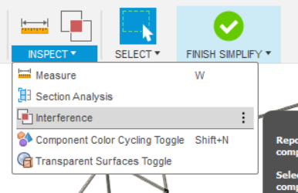
Msc things
In my personal experience (maya’s) going through simplify interference causes a TON of problems so I just don’t do it. It’s supposed to get rid of things that overlap but it creates tons of models off bits of the fuselage tubes for some reason.

